Slide 1

Mobile-based Health Care Application Using Human Activity Recognition
Student : Nguyễn Đức Dũng
Supervisor : Dr. Cao Tuấn Dũng
1
Notes:
Good morning , the committees, my name is Nguyễn Đức Dũng, I am a student of Global ICT program.
Today, I am going to present about my graduation thesis with the title of “Mobile-based Health Care Application Using Human Activity Recognition”.
The presentation will start now.

Slide 2

01
02
Context & Motivation
Objectives
03
04
Solution Approach
Main Contributions
05
Future Work
2
Notes:
My presentation have five sections including Context & Motivation, Objectives, Solution Approach, Main Contributions and the last one is Future works

Slide 3
01
Context & Motivation
3
Notes:
So now, let I describe the context and motivation that made me conduct this graduation thesis.

Slide 4
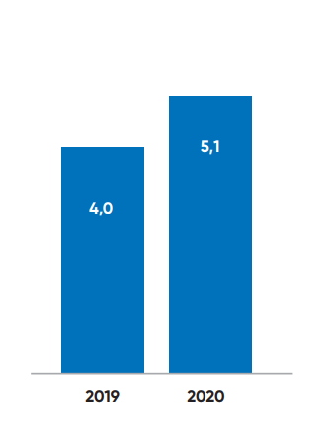
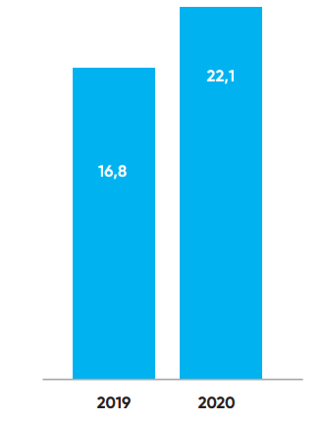
Smartphones become more popular
Average usage time per day
Average usage time per week
(*) Images are from the report of Appota.
4
Notes:
Nowadays, smartphones are gradually becoming more popular and to be one of the most important belongings in human life.
According to the report of Appota about the usage of smartphones in Vietnam in 2020, it can be easily to see that almost people in Vietnam spend a lot of time on using smartphones.
→ Therefore, healthcare applications on the smartphone are becoming more effective and convenient because users can monitor their health every time with their smartphones.

Slide 5
Human Activity Recognition in Healthcare
Identify a physical activity dependent on a trace of movement within a certain environment.
Applications appear in military healthcare, public healthcare, and smart home assistant.
5
Notes:
In healthcare field, recognizing user activity plays an essential role in realizing bad habits of users and reminding them make a change in order to have a healthy life.
Human Activity Recognition is a difficult problem with the machine because it must identify a physical activity dependent on a trace of movement within a certain environment.
With the strong growth of Machine learning and Deep learning, we can use their algorithms to solve this problem effectively.

Slide 6
Healthcare applications on store
Google Fit
Home Workout
Counts footsteps.
Connects to other wearable devices.
Records user activities in form of a diary.
Records number of performed workouts.
Has tutorials of many exercises.
Provides report of user workout.
6
Notes:
After trying some famous healthcare applications on store, I realized that users may expect a healthcare application to help them monitor their health day by day through some basic metrics and reports.
Furthermore, they also need some tutorials or advice to get a healthy life.

Slide 7
02
Objectives
7
Notes:
With mentioned motivation in previous section, the thesis has some following objectives.

Slide 8
Implementation
Implementation Model
Device
Platform
Build and train model at server.
Store model on mobile.
Smartphones
Android
8
Notes:
About the implementation of the system, the most important thing is how to implement machine learning techniques on mobile. After finding out some popular models that are usually used to implement machine learning on mobile, I decided to choose the one in which machine learning model is built and trained at server and stored directly on the mobile and research support technologies and libraries.
The target device is smartphone because of its popularity.
And the platform I chose to develop is Android since it is open for developers.

Slide 9
Main features
Count footsteps.
Recognize user activities realtime.
Provide reports.
Warn and remind user.
9
Notes:
There are four main features I would like to develop for my application.
Firstly, my application also counts number of user’s footsteps and calculates the calories burned.
It is able to recognize user activities in realtime.
Next, it provides to users daily and monthly reports so that they can review their health status.
Finally, It will give users some warns and reminds when needed.

Slide 10
03
Solution Approach
10
Notes:
After determining the objectives, I will present about the solution approach of my thesis in order to reach these objectives.

Slide 11
Recognize human activity
Input data from wearable sensors.
Sequential approach in time series analysis.
→ Use Long Short-Term Memory network.
11
Notes:
First of all, I need to solve the HAR problem.
There are 2 main approaches of this problem including vision-based and sensor-based, and in the case of developing a healthcare application on mobile, the sensor-based approach will be considered.
Because the data of wearable sensors are sequential, Deep learning algorithms like Recurrent Neural Networks play an essential role in conducting human activity recognition models.
Therefore, I decided to build a LSTM model, a kind of RNN, because it is well-suited to learn from experience to classify, process and predict time series when there are very long time lags of unknown size between important events.

Slide 12
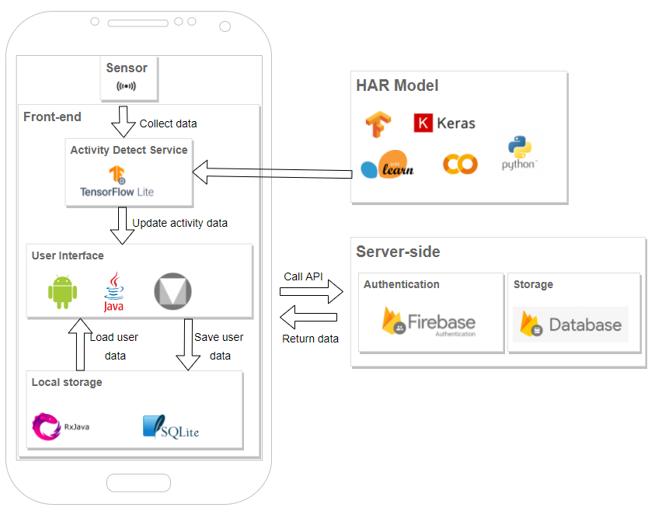
System architecture
HAR Model.
Client site.
Server site.
12
Notes:
About the system architecture, it contains 3 parts.
The first part is HAR model. At here, I built and trained the LSTM model on the server of Google Collab. After that, the model will be stored on smartphones in TensorFlow Lite format.
At the client, the application creates a service that is responsible for collecting sensor data, load the model and make predictions. The results will be updated to the screen and also saved to local storage of the smartphone.
The last part of system is server site. It was implemented with some services of Google Firebase to carry out the authentication and save the account’s information.

Slide 13
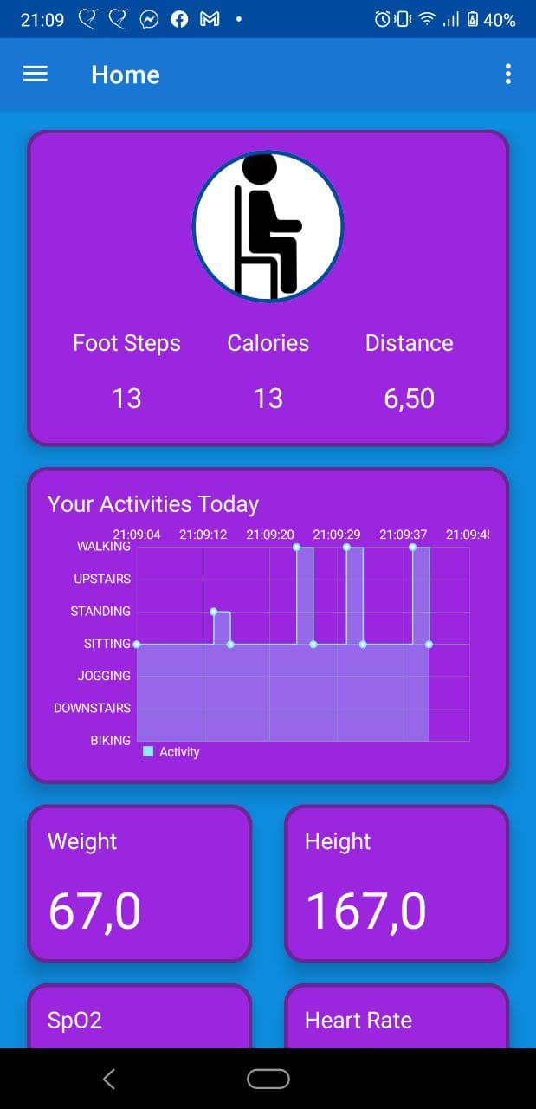
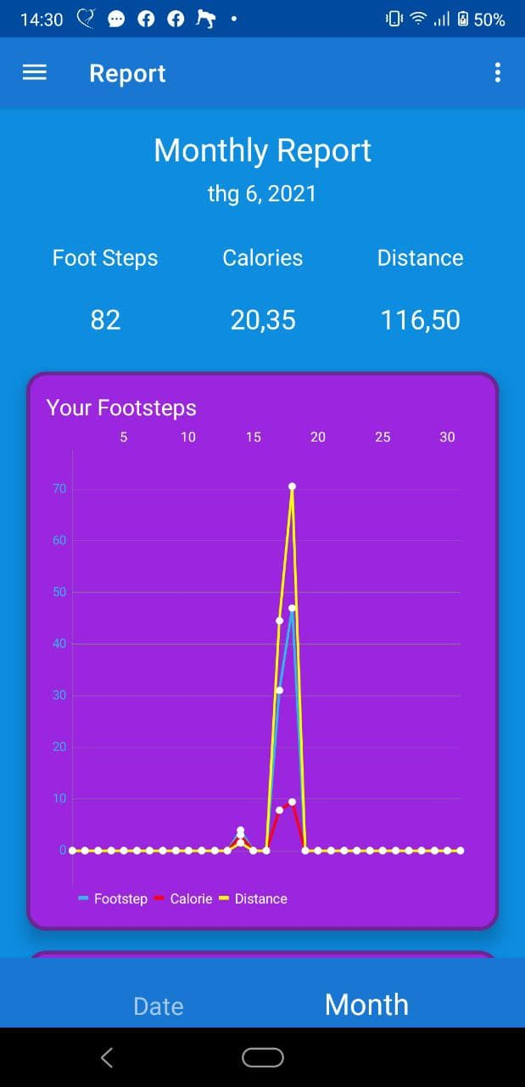
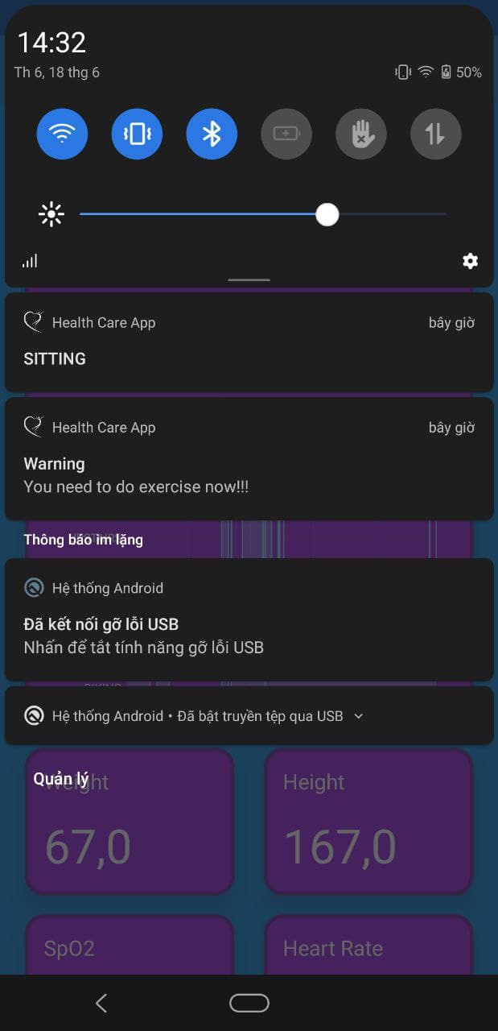
Achievement
13
Notes:
With the mentioned solution approach, I developed a healthcare application with following main screens.
Firstly, users can see their current activity that is displayed with a simple picture and their activities in whole day through a line chart in Home screen.
Furthermore, they also can review their activities of previous days and months in Report Screen.
Finally, the application will remind users do exercises if they sit or stand in a long time.

Slide 14
04
Main Contributions
14
Notes:
So now, let’s move to the fourth section . It’s about my main contributions.

Slide 15
Conclusion
Built a LSTM model.
Summarized models and techniques for implementing ML on mobile.
Published an Android module supporting recognizing human activity.
Completed a healthcare application with main features.
15
Notes:
Before talking about my main contributions, I will make a conclusion of my thesis.
My thesis has summarized the definition of the Human Activity Recognition problem, its approaches and built a LSTM model to solve it.
In addition, it has also summarized models and support technologies for implementing ML techniques on mobile.
Finally, the products of my thesis are an Android module that helps developers implement human activity recognition feature and a healthcare application that provides users the ability of monitoring their daily activities and health status and reminds users to do exercises when needed.
Among the results of my graduation thesis, my main contributions are “build a ML model to solve HAR problem” and “publish a module for recognizing human activity”.

Slide 16
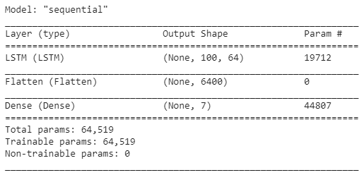
Build a LSTM model to solve HAR problem
Dataset
Model structure
“Sensors activity dataset” published by Shoaib et al.
7 physical activities.
Data of sensors of smartphones in left and right jean’s pockets.
16
Notes:
Because the limitations of the graduation thesis, I didn’t try to find out a new method to solve the HAR problem or improve the performance of the researched models.
I just tried to build and train a LSTM model, which has been used in the recent researches about this problem.
The dataset I used is the “Sensors activity dataset” published by Shoaib in the website of Twente University. It contains sensor data of wearable devices on 5 positions of human body when the participant performs 7 physical activities including Biking, Walking, Walking upstairs, Walking downstairs, Jogging, Standing and Sitting. In my case, I only used the data of smartphones on left and right jean’s pockets.
The model simply contains 3 layers. The first layer is a LSTM layer. After that is a Flatten layer and the last one is a Dense layer with Softmax activation function in order to output the probability of activities.

Slide 17
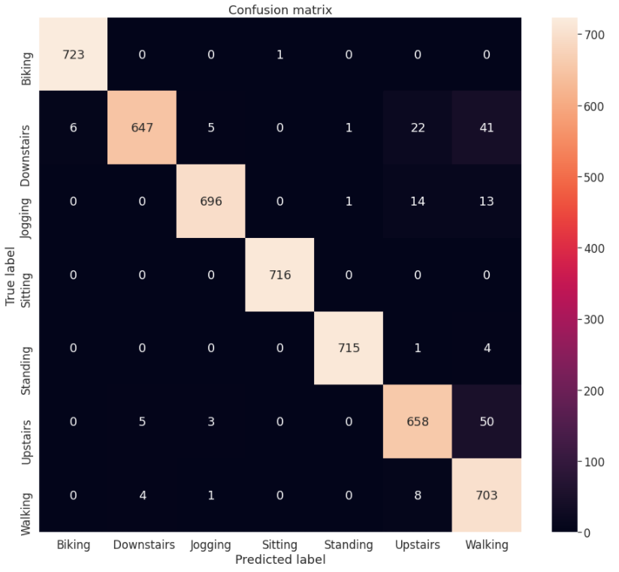
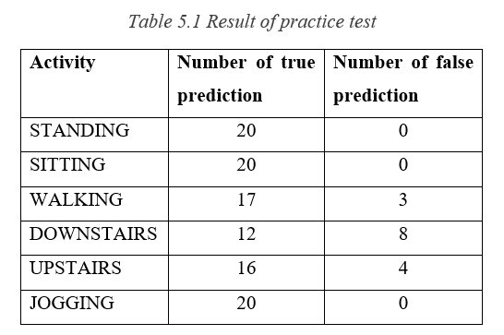
Result
Evaluation
Practice
Average accuracy of 10 training times: 94.192% (+/- 1.767).
17
Notes:
After training with the dataset, I have got a model having a quite high accuracy with this dataset.
The average accuracy of 10 training times is approximate 94 percent.
When I see the confusion matrix of my model when it is evaluated with the testing dataset, I realized that this model often make mistakes when distinguishing among walking, walking upstairs and walking downstairs.
After that, I tested my model with a practice exam. I developed a simple feature on my application that recognizes user’s activity and speaks out this activity. After that I left my smartphone on the left jean’s pocket and performed each of 6 activities shown in Table 5.1 20 times. The accuracy got from this exam is 87.5 percent and the drawback of the model also happened.

Slide 18
Build a module for recognizing human activity
Be easier to implement recognizing human activity feature.
Reuse this feature in other projects.
Support reformatting sensor data.
Support storing, loading and calling model.
18
Notes:
After building and training a LSTM model, I found a problem that I might need to reuse the feature of recognizing human activity in my other projects in the future or someone might request me to help them implement this feature in their project.
Therefore, I decided to build and publish a module for recognizing human activity. This module supports developers reformatting sensor data, storing, loading and calling the LSTM model to make predictions.

Slide 19
05
Future Work
Improve performance of LSTM model.
Finish incomplete features.
Improve service to consume less power.
Improve UI.
19
Notes:
In the last section, I will tell about the future work of my graduation thesis.
Firstly, the model has some drawbacks like
Often make mistakes when recognizing walking, upstairs and downstairs activities.
Require the smartphone to be put on the right direction.
So I want to improve the accuracy of this model and also make it be able to recognize other activities of user in daily life.
Secondly, because my healthcare application has not be completed, I need to finish incomplete features such as family feature, add more exercise tutorials and advice.
Finally, I would like to improve the service of my application so that it consumes less power and the user interface to be user-friendly.

Slide 20
Thank You for Listening
Questions and Answer !
20
Notes:
This is the end of the presentation on my graduation thesis.
I send my deepest gratitude to Dr. Cao Tuấn Dũng for his tremendous help on the finishing of my thesis.
Despite giving my all for this, because of my limited knowledge, I am sure that my thesis is yet to be without shortcomings. I would love to receive comments from teachers and fellow students to further perfect my graduation thesis.
Thank you.

Slide 21
Implement machine learning model on mobile
Freezing graph model.
TensorFlow JS.
TensorFlow Lite.
Firebase ML Kit.
12
Notes:
There are four ways that I can use to store a machine learning model directly on mobile and use it to make predictions.
The first way is to freeze graph model with its checkpoints and hyper-parameters. However, this way is not usually used at present.
The second way is to use the TensorFlow Js library for React Native.
The next way is to use the TensorFlow Lite framework.
The last one is to use Firebase ML Kit. This ML Kit provides many pre-trained models and APIs to use them. It also supports developers implementing a custom model with TensorFlow Lite.
→ I decided to use TensorFLow Lite because it is quite simple to implement.

Slide 22
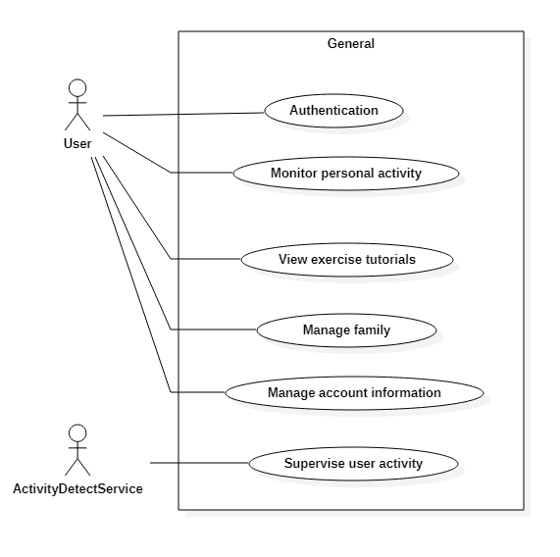
Notes:
In order to solve HAR problem with this approach, traditional models were built by machine learning approaches from extracting features to classifying and prediction activity patterns, in which Hidden Markov Model and Support Vector Machine are always more popular previously.

Slide 23
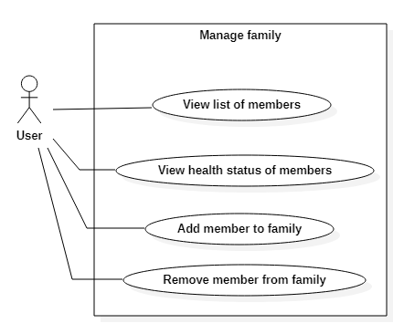
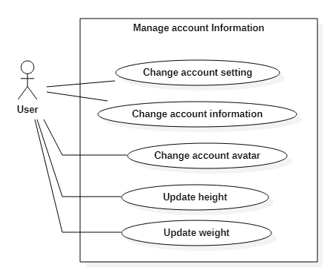

Slide 24
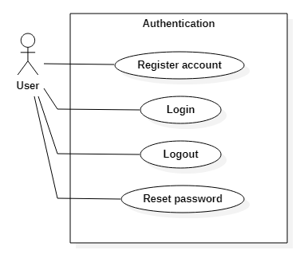
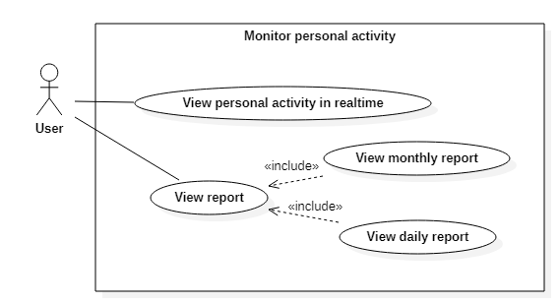

Slide 25
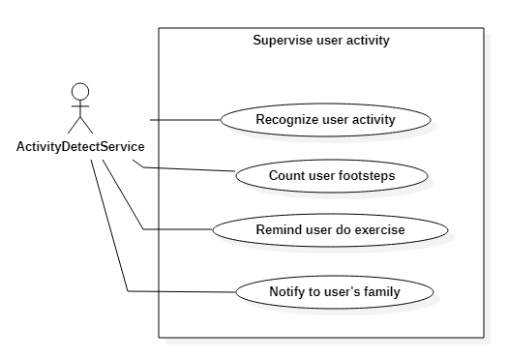

Slide 26
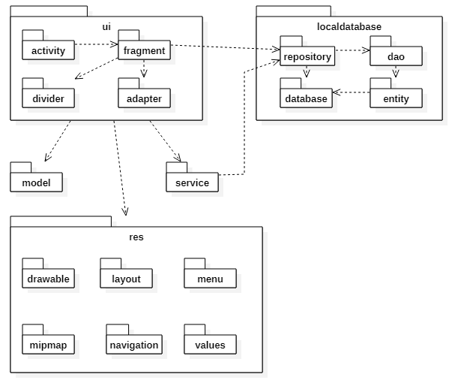

Slide 27
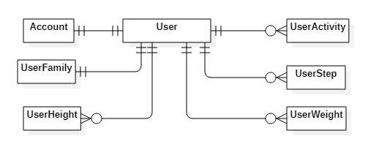

Slide 28
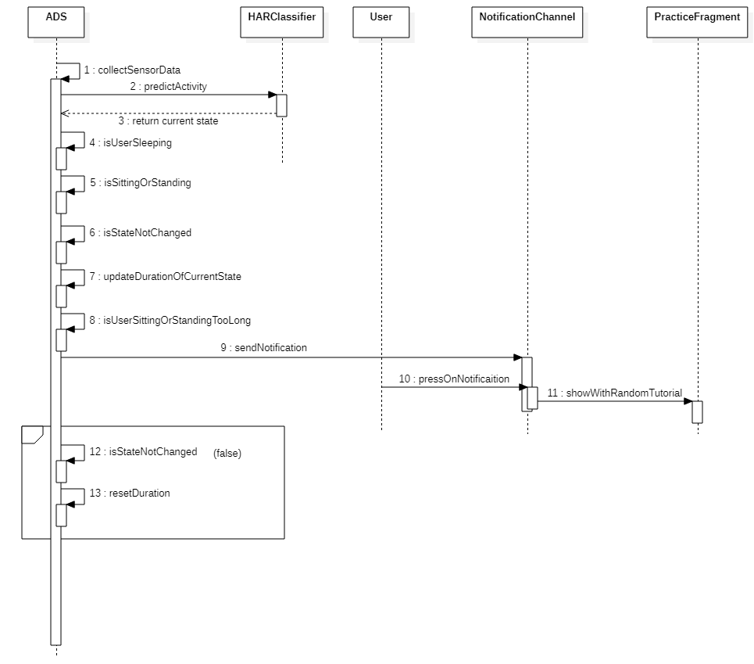

Slide 29
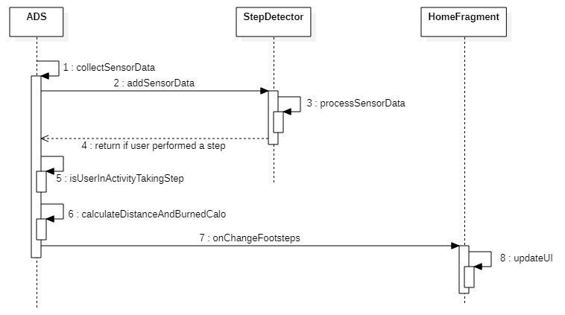

Slide 30
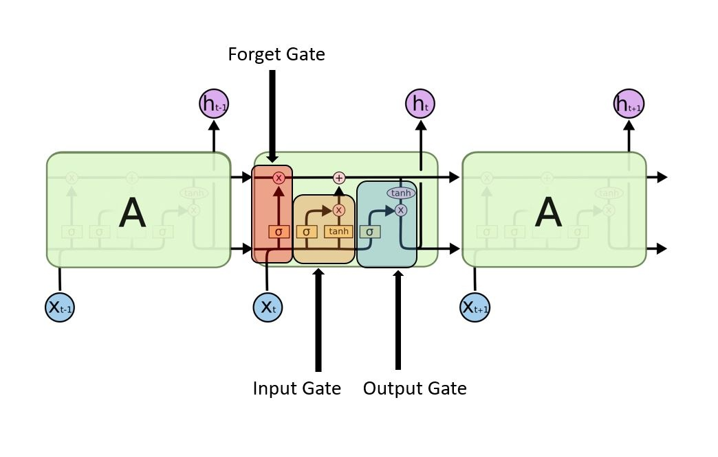

Slide 31
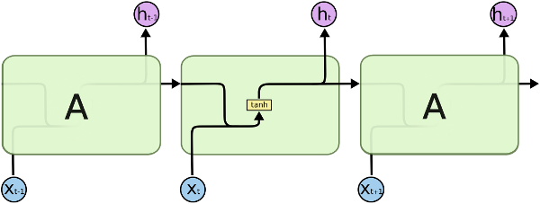

Slide 32
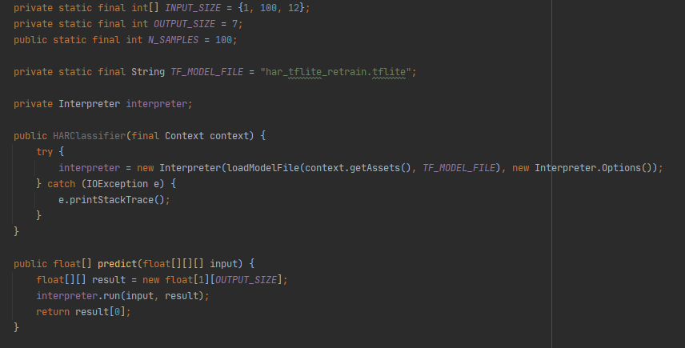

Slide 33
